Slide 1
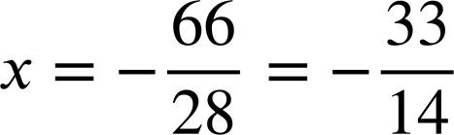
Solving complex linear equations involving brackets
Task A: Solving equations with multiple sets of brackets
1) Fill in the blanks to complete these two equations.
a)
2(5x + 1) + 5(x − 7) | = | 27
10x + 2 + 5x − 35 | = | 27
15x − 33 | = | 27
15x | = | 60
x | = | 4
b)
4(2x + 6) + 7(4 − x) | = | 2(2x − 7)
8x + 24 + 28 − 7x | = | 4x − 14
x + 52 | = | 4x − 14
52 | = | 3x − 14
66 | = | 3x
x | = | 22
2) Each solution contains an error. Identify it and write a sentence explaining why it is wrong.
a)
2(7x + 4) + 3x | = | 88
14x + 8 + 6x | = | 88
20x + 8 | = | 88
20x | = | 80
x | = | 4
You may have written:
The terms 7x and 4 are inside the bracket so are correctly multiplied by 2 but, the term 3x sits outside the bracket on its own so should not have been multiplied.
3(2y + 7) − 5(y + 1) | = | 7(3y − 2)
6y + 21 − 5y + 5 | = | 21y − 14
y + 26 | = | 21y − 14
26 | = | 20y − 14
40 | = | 20y
y | = | 2
b)
The second bracket was incorrectly multiplied out. It should multiply out as −5(y + 1) = −5y − 5
The term should be −5, not +5
3) Solve:
a)
2(7x − 3) + 4(x + 9) | = | 12
14x − 6 + 4x + 36 | = | 12
18x + 30 | = | 12
18x | = | −18
x | = | −1
b)
3(2x + 6) + 5(x + 1) | = | 9(x + 3)
6x + 18 + 5x + 5 | = | 9x + 27
11x + 23 | = | 9x + 27
11x | = | 9x + 4
2x | = | 4
x | = | 2
c)
4(2a + 7) | = | 12a − 6(a + 8)
8a + 28 | = | 12a − 6a − 48
8a + 28 | = | 6a − 48
2a + 28 | = | −48
2a | = | −76
a | = | −38
d)
7(3x − 4) + 8(2 − 5x) | = | 9(x + 6)
21x − 28 + 16 − 40x | = | 9x + 54
−19x − 12 | = | 9x + 54
−12 | = | 28x + 54
−66 | = | 28x

Slide 2
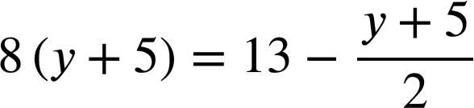
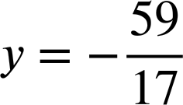
Solving complex linear equations involving brackets
Task B: Simplifying before solving
1) Solve these equations twice. Firstly by expanding first, secondly by simplifying before expanding.
Write a sentence to compare the efficiency.
a)
9(x + 4) + 2(x + 4) | = | 99
9x + 36 + 2x + 8 | = | 99
11x + 44 | = | 99
11x | = | 55
x | = | 5
9(x + 4) + 2(x + 4) | = | 99
11(x + 4) | = | 99
x + 4 | = | 9
x | = | 5
You may have written:
Simplifying identical expressions was more efficient, with simpler steps.
b)
7 + 5(x − 3) | = | 8(x − 3) − 2(x − 3)
7 + 5x − 15 | = | 8x − 24 − 2x + 6
−8 + 5x | = | 6x − 18
10 + 5x | = | 6x
x | = | 10
7 + 5(x − 3) | = | 8(x − 3) − 2(x − 3)
7 + 5(x − 3) | = | 6(x − 3)
7 | = | x − 3
x | = | 10
You may have written:
Simplifying identical expressions was again more efficient, and also avoided a lot of manipulating negative terms.
2) Solve:
a)
4x + 24 + 9(x + 6) | = | 24 + 11(x + 6)
4(x + 6) + 9(x + 6) | = | 24 + 11(x + 6)
13(x + 6) | = | 24 + 11(x + 6)
2(x + 6) | = | 24
x + 6 | = | 12
x | = | 6
b)
16(y + 5) | = | 26 − (y + 5)
17(y + 5) | = | 26
17y + 85 | = | 26
17y | = | −59
Mathematics in Education and Industry.
v2.3

